Slide 1
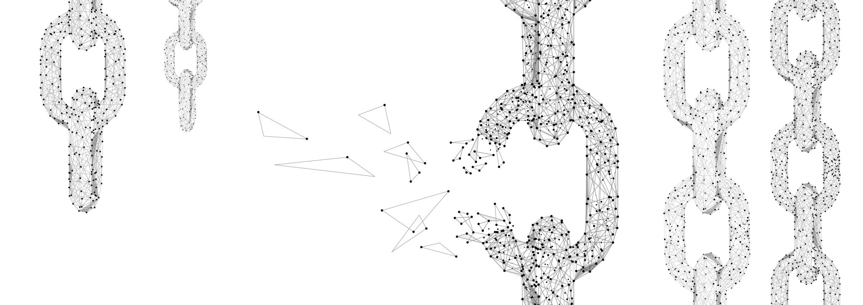
Blockchain Technology
Assignment 3

Slide 2
Simulation of Transaction Pinning Attack

Slide 3
What it means?
A pinning attack occurs when a malicious participant (usually a miner or a node) deliberately withholds or delays the broadcasting of a transaction to manipulate the system. This tactic is commonly used in decentralized applications (dApps) or systems that depend on time-sensitive transactions.

Slide 4
How it works?
A user (victim) creates a transaction (e.g., paying for a service or transferring tokens) and submits it to the blockchain network. Malicious Node/ Miner Spots the Transaction:
A malicious actor (node or miner) notices this transaction in the mempool (pending transactions waiting to be confirmed).Pinning the Transaction:
The attacker pins this transaction by broadcasting their own dependent transaction (e.g., a high-priority, but invalid one), ensuring that the victim's transaction cannot be processed until their dependent transaction is confirmed. This essentially locks the victim's transaction in the mempool for a prolonged period. Delayed Confirmation:
The victim’s transaction remains unconfirmed for a longer time, potentially causing issues for time-sensitive activities (e.g., auctions, flash loans, or contract executions).Exploiting the Delay:

Slide 5
Demonstration

Slide 6
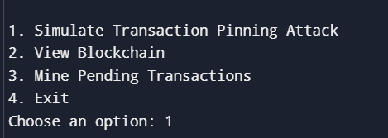
Step 1
We start off by selecting the option to simulate the attack

Slide 7
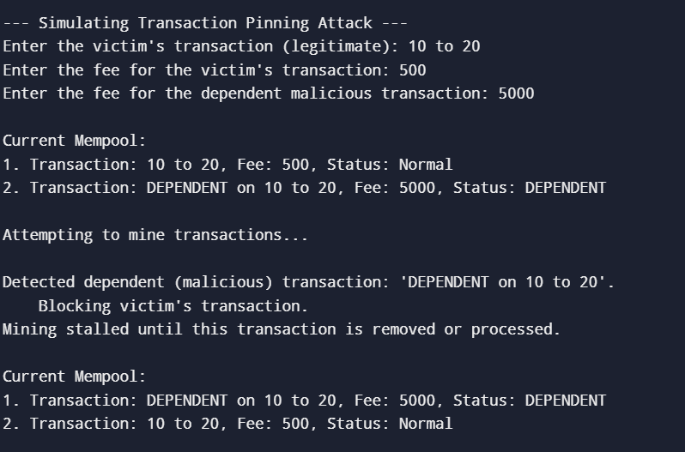
Step 2
We fill the details and view the current mempool.

Slide 8
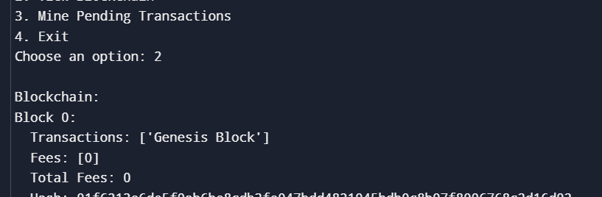
Step 3
We check if the block has been added to the blockchain or not.

Slide 9
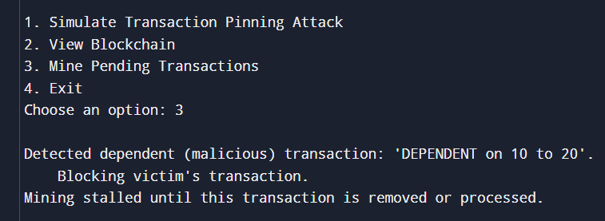
Step 4
We try to mine the pending transaction in hopes the victim’s transaction will be added.

Slide 10
Results
If a dependent transaction is present, the victim's transaction won’t be mined.
The chain and mempool show the attack's effect, simulating how a victim’s transaction remains trapped in the mempool due to an invalid dependent transaction.

Slide 11

Thank You

